Slide 1
assignment05 – Part 2 SkateRampArea

Slide 2
Read
assignment05 on volosin.lmu.build before you begin

Slide 3
Part 1
The sin function

Slide 4

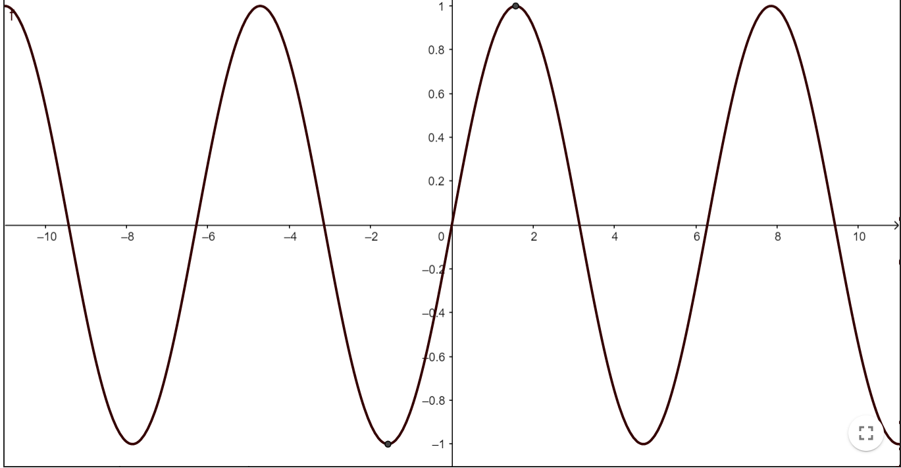
The purpose of this assignment is to estimate the area under a curve
The curve represents the Skate Ramp. We are looking for the area under the curve to see how much plywood we need to cover the side.

Slide 5
The purpose of this assignment is to estimate the area under a curve
To estimate the area, we are given the following pieces of information
A Function sin
Coefficients of x none
Upper Bound 4
Lower Bound 1
Optional % 1%

Slide 6
Given the function and the coefficients, we can write out the sin function as…
A Function sin
Coefficients of x none
Upper Bound 4
Lower Bound 1
Optional % 1%
sin(x)

Slide 7
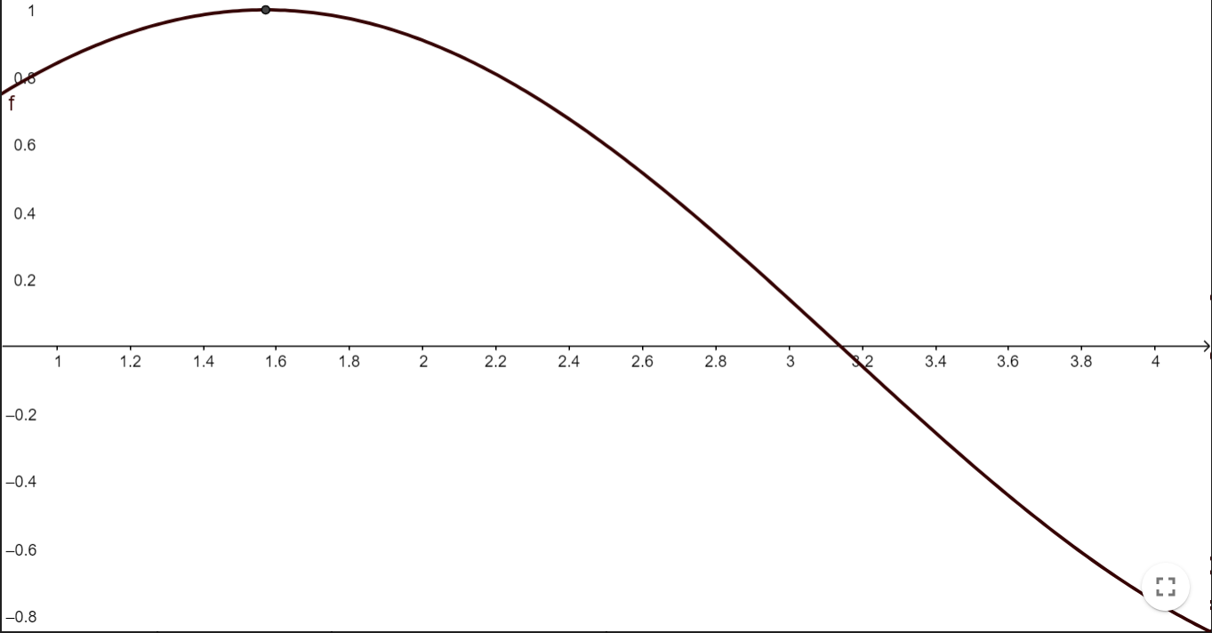
Graphed
A Function sin
Coefficients of x none
Upper Bound 4
Lower Bound 1
Optional % 1%
sin(x)
This is the graph of this function

Slide 8
Upper and Lower Bounds
A Function sin
Coefficients of x none
Upper Bound 4
Lower Bound 1
Optional % 1%
sin(x)
The upper and lower bounds tell us between which 2 x values to find the area.
Lower Bound
Upper Bound

Slide 9
Find the area between the UB and LB and under the curve
A Function sin
Coefficients of x none
Upper Bound 4
Lower Bound 1
Optional % 1%
sin(x)
The upper and lower bounds tell us between which 2 x values to find the area.
Lower Bound
Upper Bound

Slide 10
Positive and negative area
Length of the rectangle is always positive, but the yCoord can be positive or negative depending on if it is above or below the x-axis
Pos Length, Pos y = Positive area
Pos Length, Neg y = Negative area
Positive
Positive
Negative
Negative

Slide 11
Part 2
Solving the problem

Slide 12
Let’s solve for the area under the curve using the same steps we used for poly
sin(x)
A Function sin
Coefficients of x none
Upper Bound 4
Lower Bound 1
Optional % 1%
Lower Bound
Upper Bound

Slide 13
1 Rectangle
A Function sin
Coefficients of x none
Upper Bound 4
Lower Bound 1
Optional % 1%
sin(x)
ESTIMATE 1 | How | This problem
Find the length of each rectangle | length = ( ub – lb ) / numRect | ( 4 – 1 ) / 1 => 3
Midpoint of each rectangle | midpoint = lb + (( length / 2 ) * (rectNum*2)-1) | 1 + ((4 - 1) / 2 ) * ((1*2) -1) => 2.5
Find y coord ofeach midpoint on the curve | yCoord = function(midpoint) | sin(2.5) => .5985
Sum the area of each rectangle | length * yCoord | 3 * .5985 => 1.7955
.5985
2.5
Lower Bound
Midpoint
Upper Bound

Slide 14
2 Rectangles
A Function sin
Coefficients of x none
Upper Bound 4
Lower Bound 1
Optional % 1%
sin(x)
ESTIMATE 2 | How | This problem
Find the length of each rectangle | length = ( ub – lb ) / numRect | (4 – 1) / 2 => 1.5
Midpoint of each rectangle | midpoint = lb + (( length / 2 ) * (rectNum*2)-1) | rectNum = 1 1 + ( (1.5/2) * 1 ) 1.75 rectNum = 2 1 + ( (1.5/2) * 3 ) 3.25
Find y coord of each midpoint on the curve | yCoord = function(midpoint) | rectNum = 1 sin(1.75) .9839 rectNum = 2 sin(3.25) => -.1082
Sum the area of each rectangle | length * yCoord | rectNum = 1 1.5 * .9839 1.476 rectNum = 2 1.5 * -1.082 -0.1623 1.314
.9839
-.1082
2.5
Lower Bound
Midpoint
Upper Bound

Slide 15
Optional %
A Function sin
Coefficients of x none
Upper Bound 4
Lower Bound 1
Optional % 1%
previousArea = 1.7955
currentArea = 1.314
1 – ( 1.314 / 1.7955 )
.27 <= .01
FALSE

Slide 16
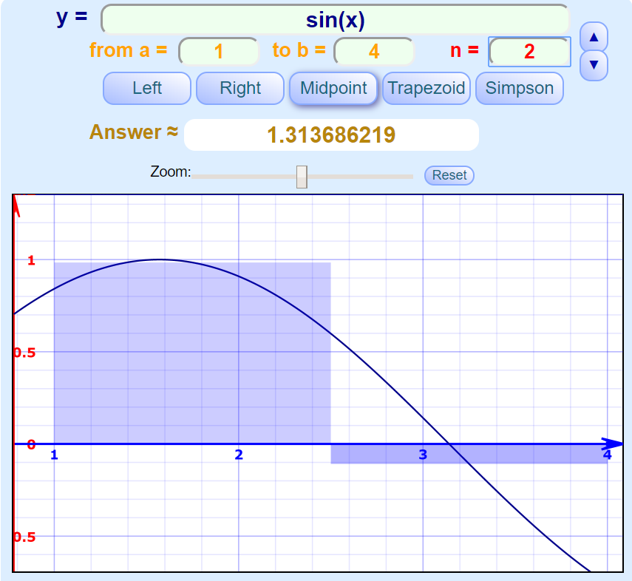
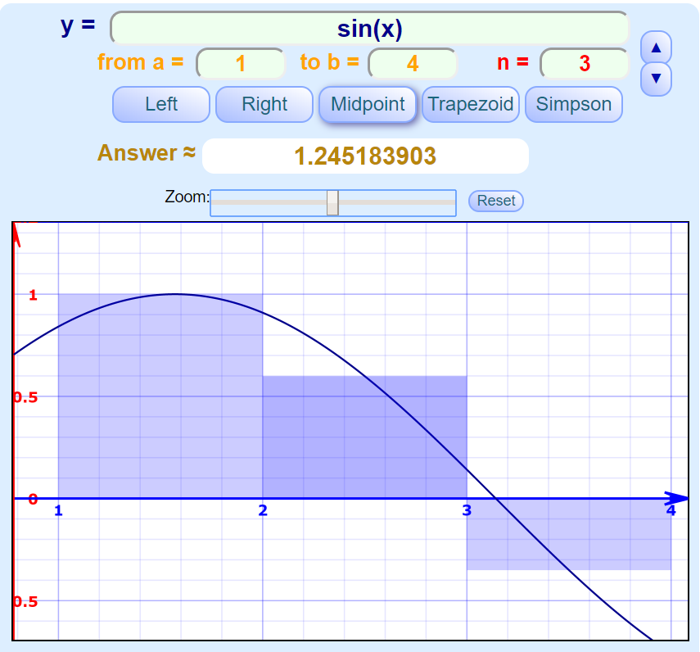
3 Rectangles
previousArea = 1.314
currentArea = 1.245
1 – ( 1.245 / 1.314 )
.05 <= .01
FALSE

Slide 17
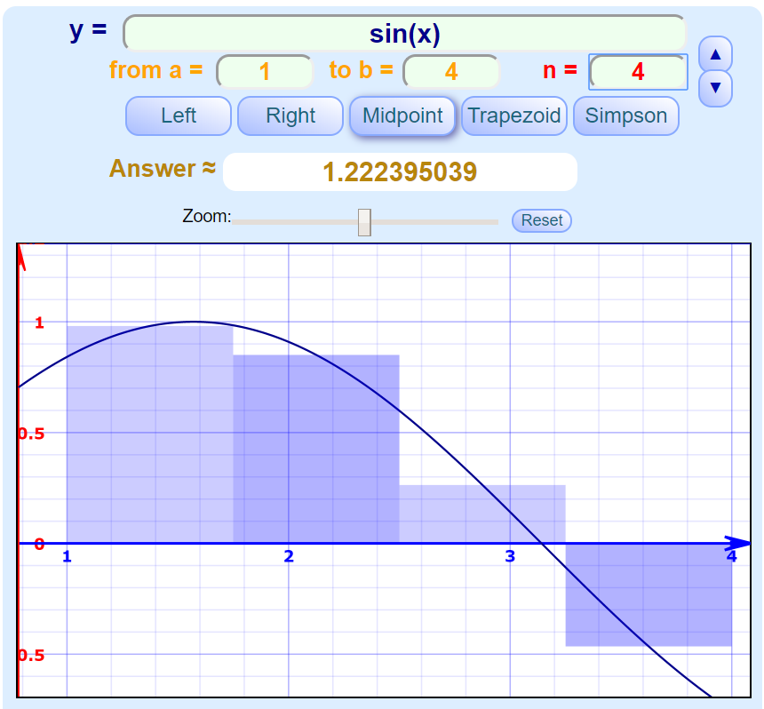
4 Rectangles
previousArea = 1.245
currentArea = 1.2224
1 – ( 1.2224 / 1.245 )
.018 <= .01
FALSE

Slide 18
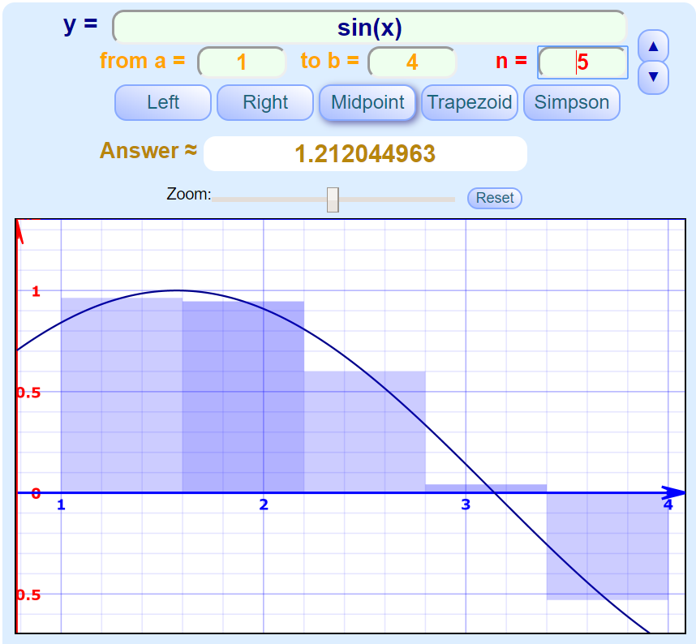
5 Rectangles
previousArea = 1.2224
currentArea = 1.212
1 – ( 1.212 / 1.2224 )
.0086 <= .01
TRUE

Slide 19
Area found!
The area under the poly curve,
Between 1 and 4 is 1.212 after using 5 rectangles
sin(x)
currentArea = 1.212

Slide 20
Part 3
Arguments for your program

Slide 21
SkateRampArea Arguments
If the last argument has a % sign in it, it is the optional percentage
If the last argument does not have a % sign in it, it is the upper bound
The argument before the upper bound is the lower bound
The first argument is the function
All other arguments are coefficients
java SkateRampArea sin 1 4 1%
Function
Optional %
Upper Bound
Lower Bound
sin(x)

Slide 22
SkateRamp Arguments - Coefficients
java SkateRampArea sin 1 4
Function
Upper Bound
Lower Bound
sin(x)

Slide 23
Riemann Integration
This method of finding the area under the curve is called Riemann Integration.
You can check your work here –
https://www.mathsisfun.com/calculus/integral-approximation-calculator.html

